Slide 1
Chapter 2
Network Models

Slide 2
Layered Task:
We use the concept of layers in our daily life. As an example, let us consider two friends who communicate through postal mail. The process of sending a letter to a friend would be complex if there were no services available from the post office.
Sabbir Hossen

Slide 3
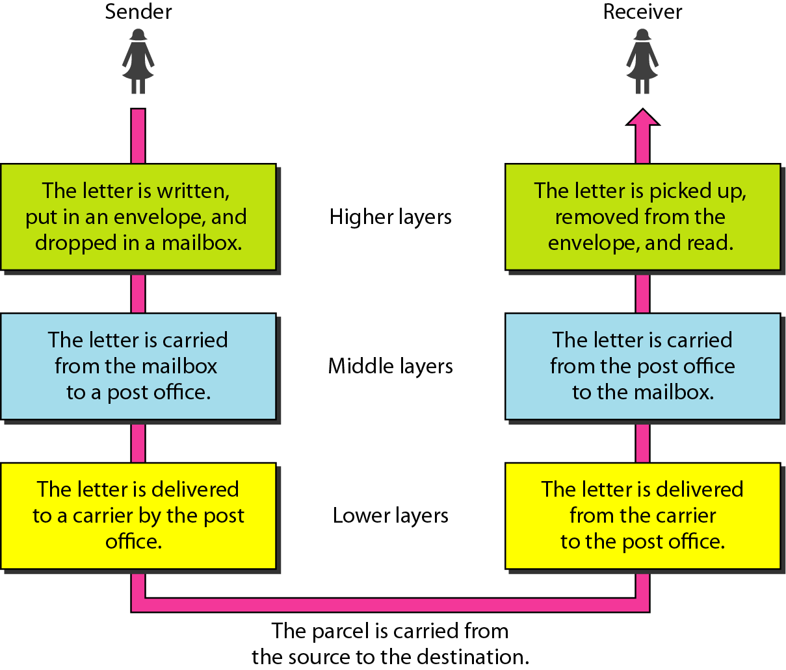
Tasks involved in sending a letter
Sabbir Hossen

Slide 4
OSI Model:
Established in 1947, the International Standards Organization (ISO) is a multinational body dedicated to worldwide agreement on international standards. An ISO standard that covers all aspects of network communications is the Open Systems Interconnection (OSI) model. It was first introduced in the late 1970s.
ISO is the organization.
OSI is the model.
Sabbir Hossen

Slide 5
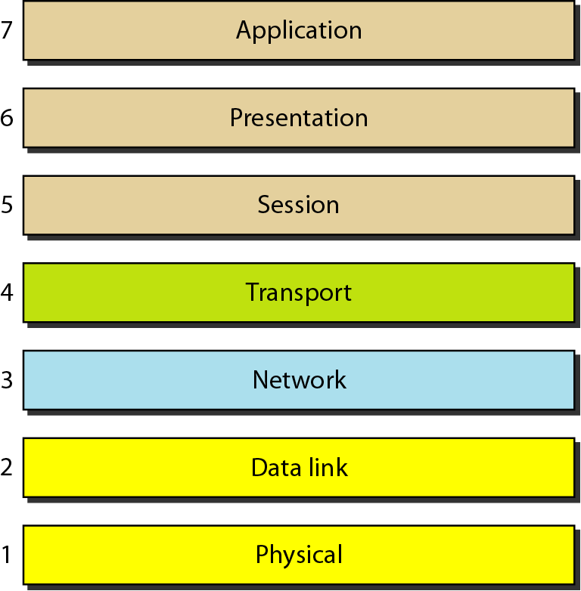
Seven layers of the OSI model:
Sabbir Hossen

Slide 6
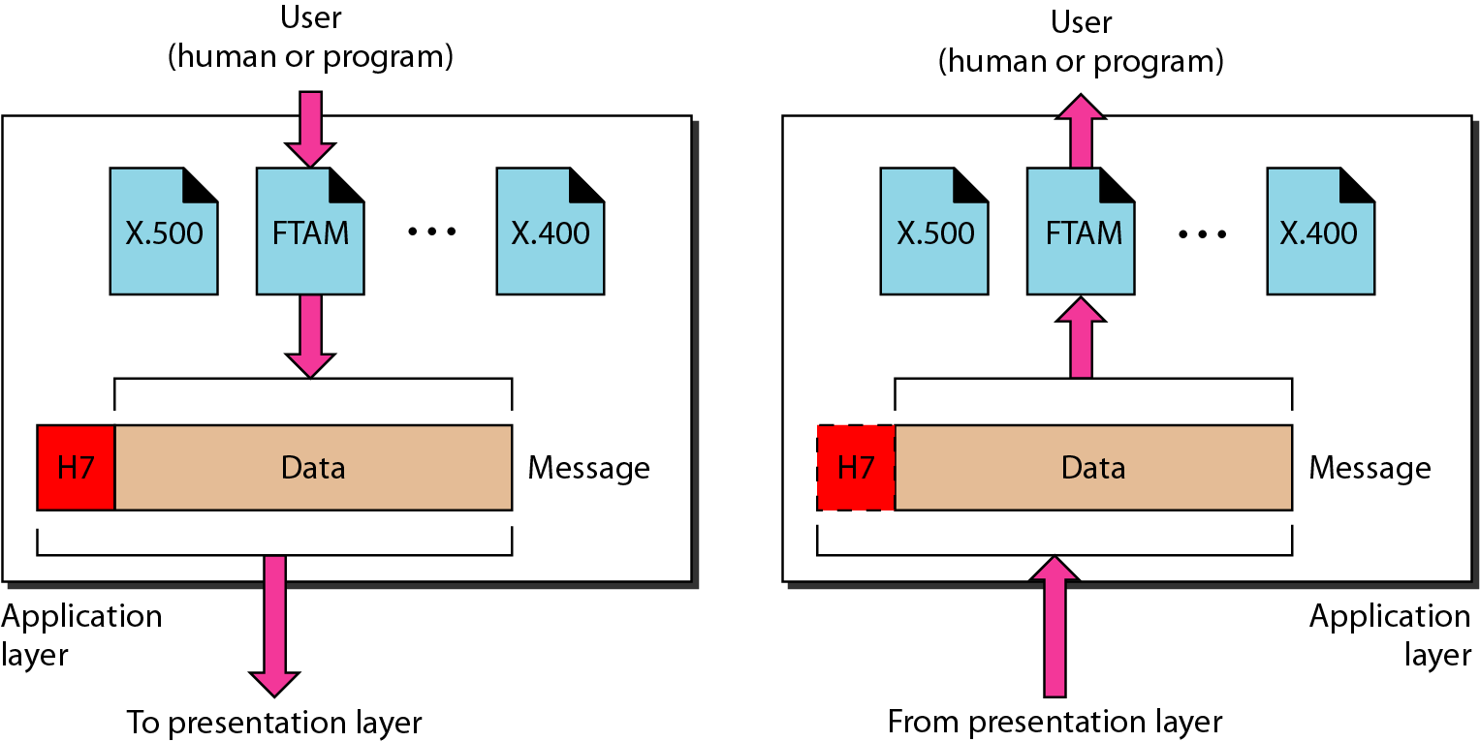
Application layer:
The application layer is responsible for providing services to the user.
Services: Computer Application Chrome, Mozilla Firefox
Sabbir Hossen

Slide 7
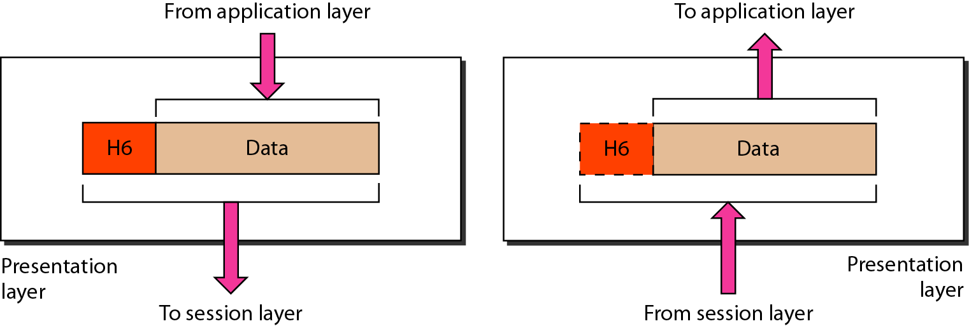
Presentation layer:
The presentation layer is responsible for translation, compression, and encryption
Services: Translation, Data Compression, Encryption
Sabbir Hossen

Slide 8
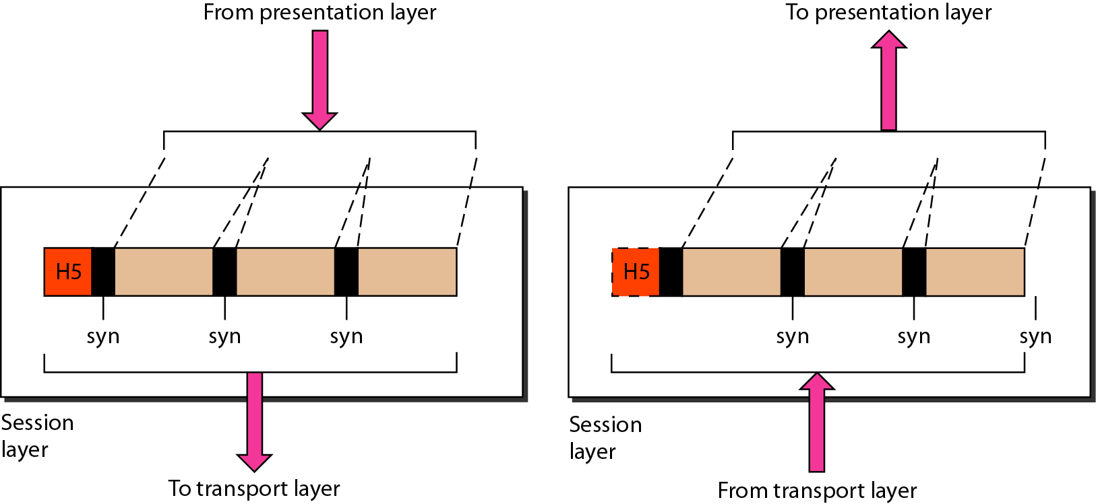
Session layer:
The session layer is responsible for establishing, managing and terminating connections between applications
Services: Session Management, Authentication, Authorization, Interaction management (Simplex, half-duplex, full-duplex)
Sabbir Hossen

Slide 9
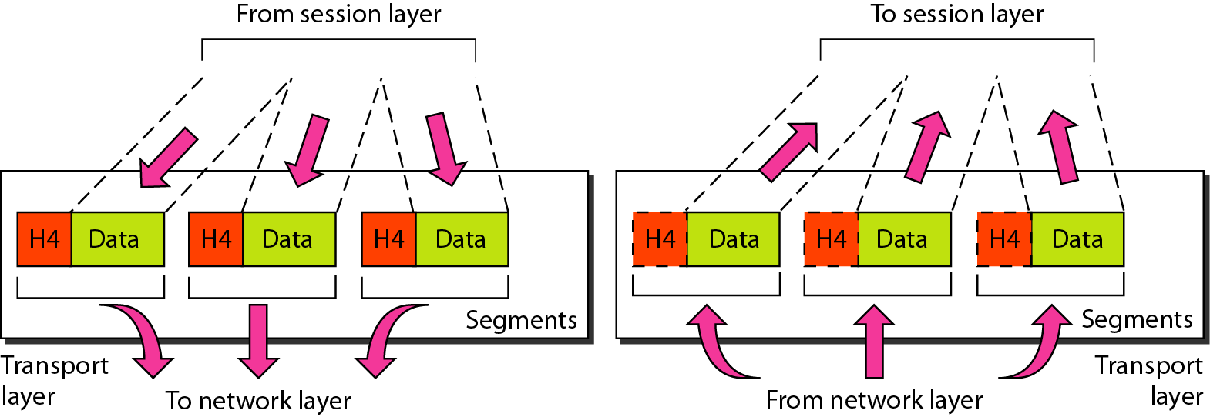
Transport layer:
The transport layer is responsible for the delivery of a message from one process to another.
Services
  Port addressing
  Segmentation and reassembly
  Connection control
  Flow control (end-to-end)
  Error control (end-to-end)
Sabbir Hossen

Slide 10
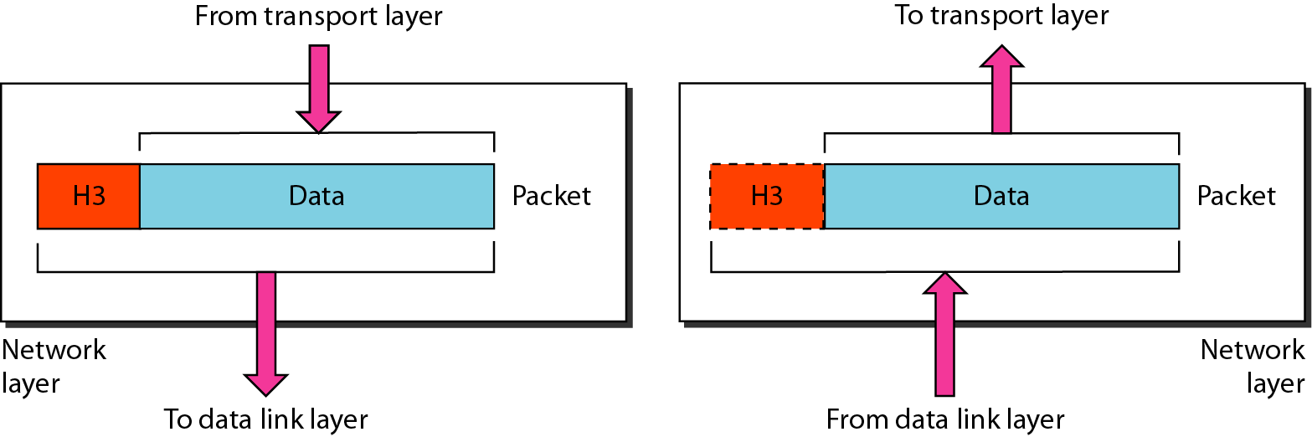
Network layer:
The network layer is responsible for the delivery of individual packets from the source host to the destination host.
Services
  Logical addressing
  IPv4, IPv6
  Routing
Sabbir Hossen

Slide 11
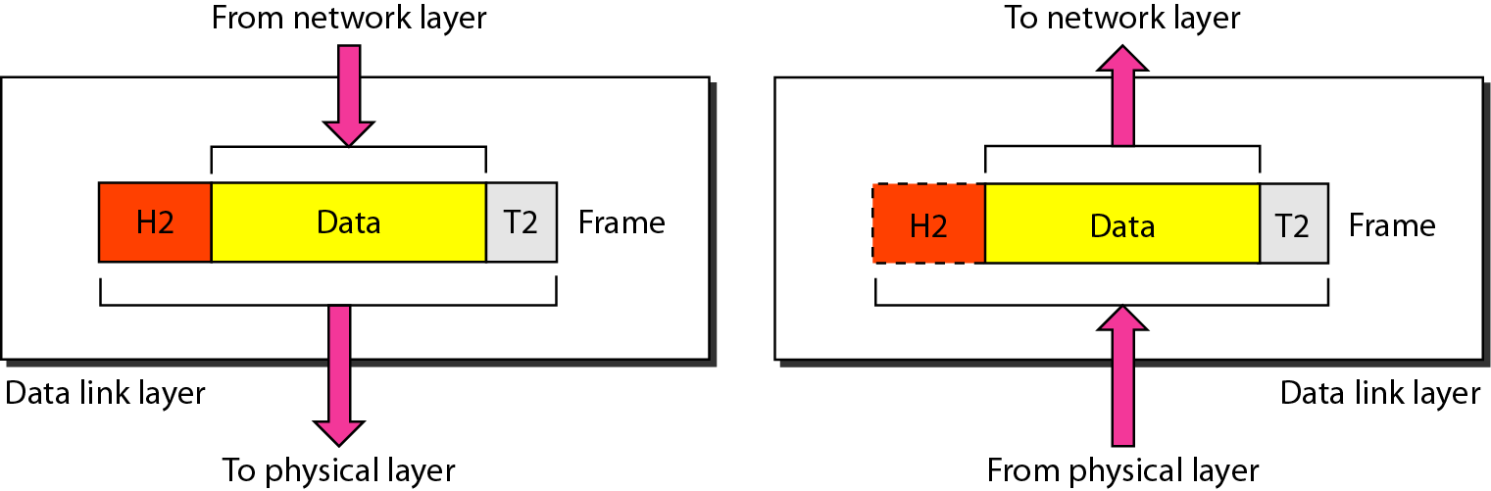
Data link layer:
The data link layer is responsible for moving
frames from one hop (node) to the next.
Services
  Framing
  Physical addressing
  Flow control (hop-to-hop)
  Error control (hop-to-hop)
  Access control
Sabbir Hossen

Slide 12
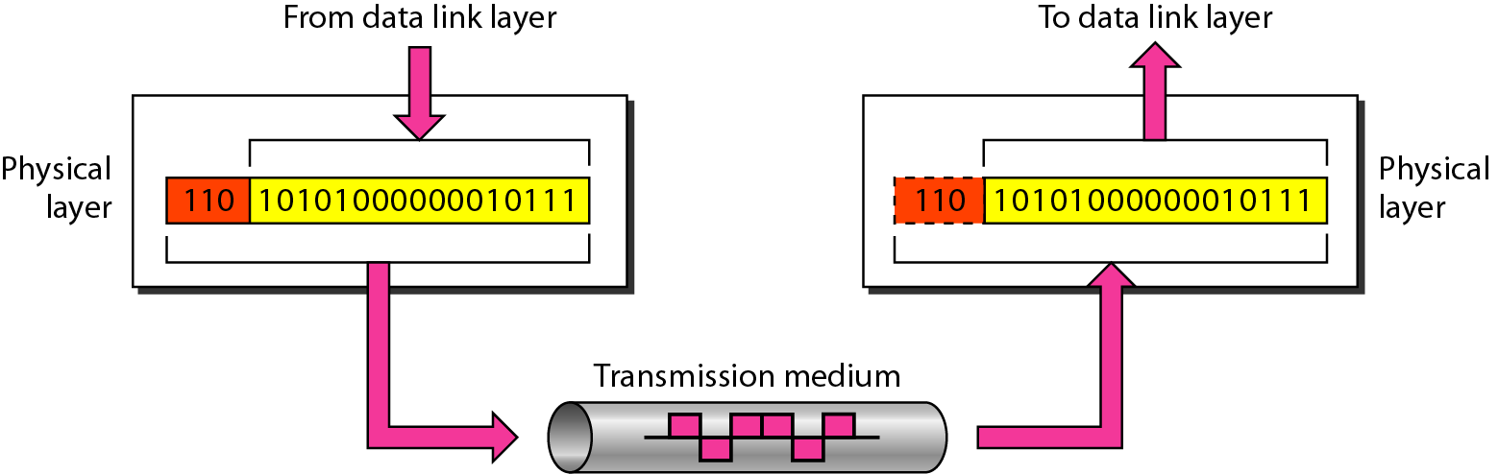
Physical layer:
Responsible for transmitting individual bits from one node to the next.
Services:
  Physical characteristics of interfaces and media
  Representation of bits
  Data rate (transmission rate)
  Synchronization of bits
Sabbir Hossen

Slide 13
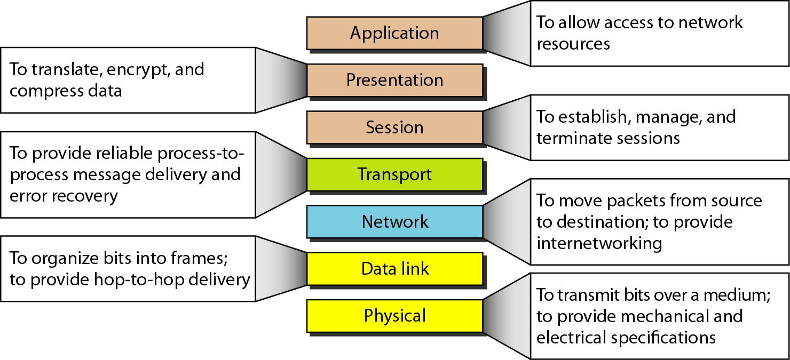
Summary of layers:
Sabbir Hossen

Slide 14
Internet Protocol Suite:
Layer | Protocols
Application | HTTP, FTP, Telnet, SMTP, ...
Transport | TCP, UDP, SCTP, ...
Network | IP (IPv4), IPv6, ICMP, IGMP, ...
Data Link | Ethernet, Wi-Fi, PPP, ...
Physical | RS-232, DSL, 10Base-T, ...
Sabbir Hossen

Slide 15
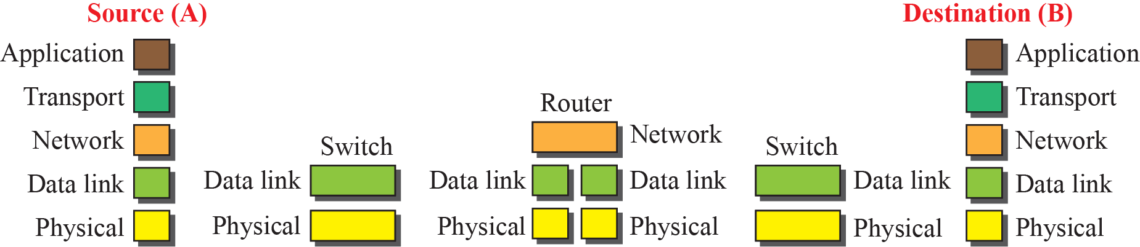
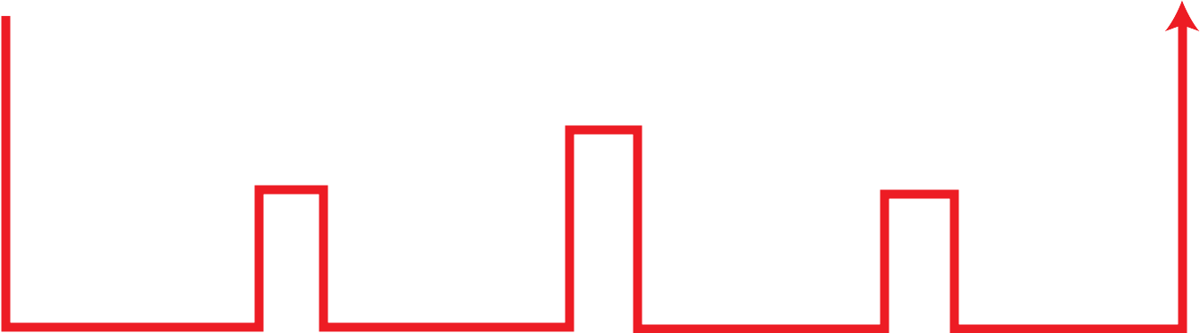
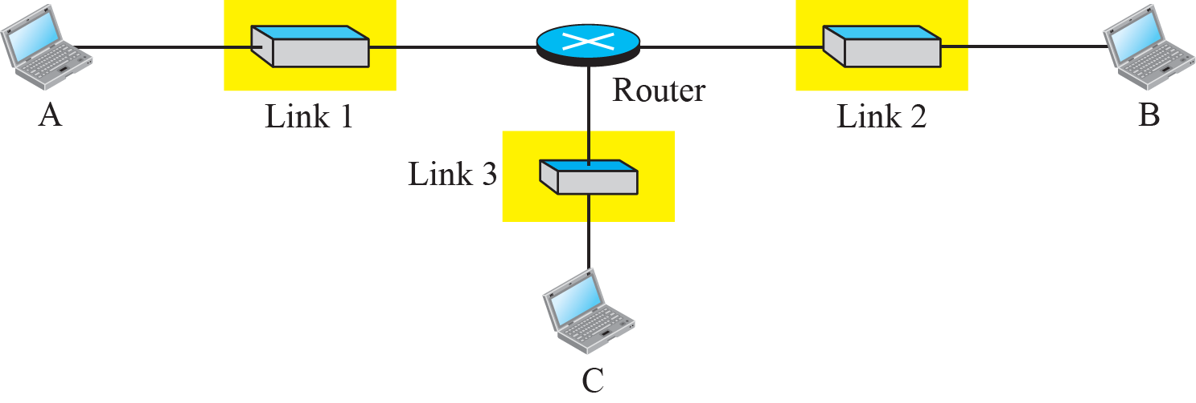
Communication through an internet
Sabbir Hossen
Notes:
1.#

Slide 16
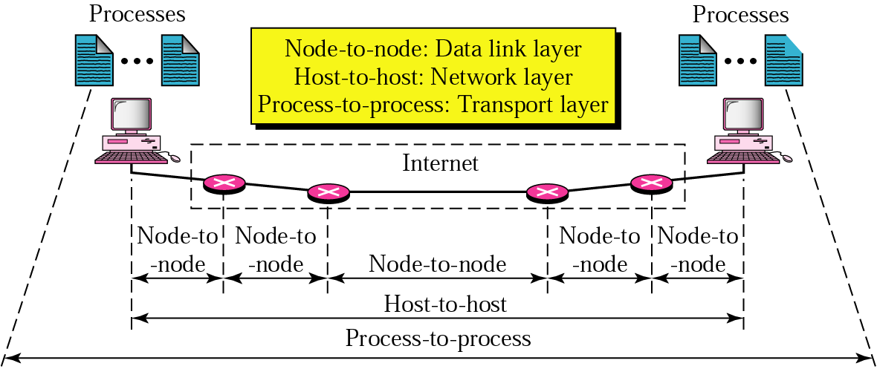
Internet Model:
Sabbir Hossen

Slide 17
TCP/IP Protocol:
When TCP/IP is compared to OSI, we can say that the TCP/IP protocol suite is made of five layers: physical, data link, network, transport, and application.
Sabbir Hossen

Slide 18
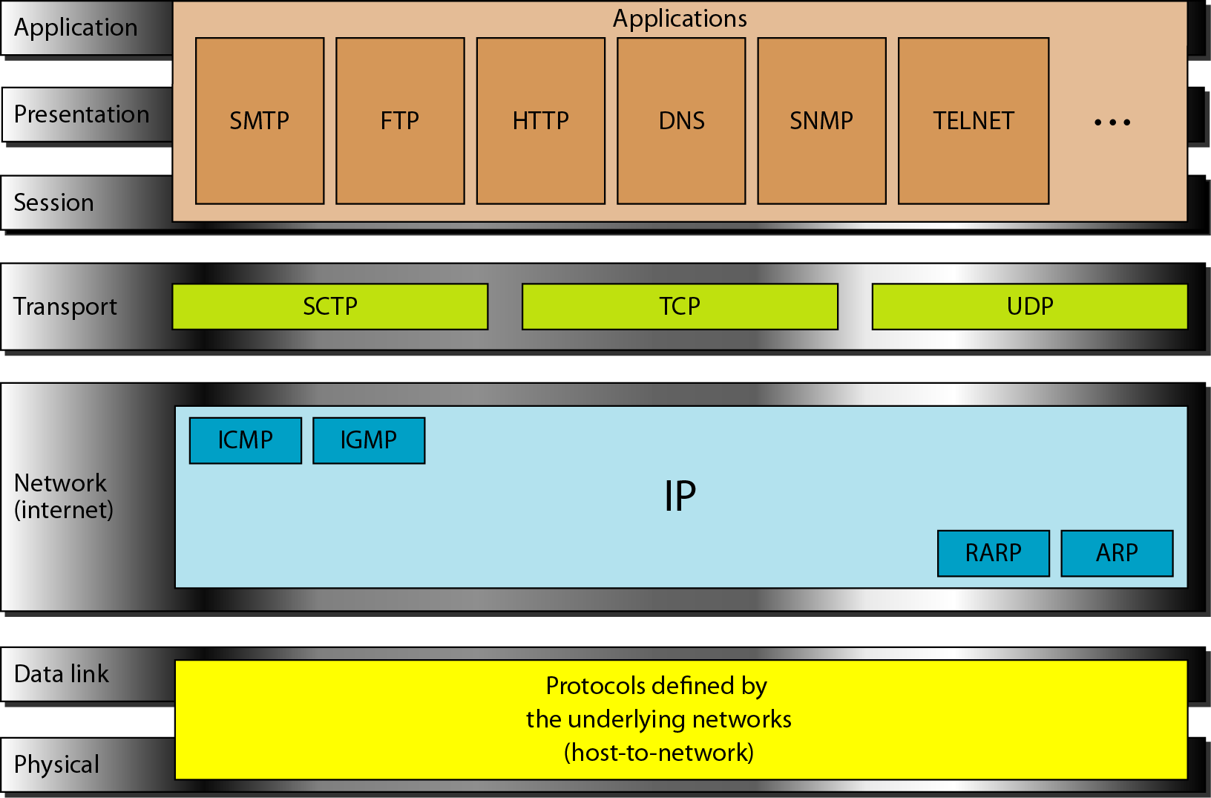
TCP/IP and OSI model
Sabbir Hossen

Slide 19
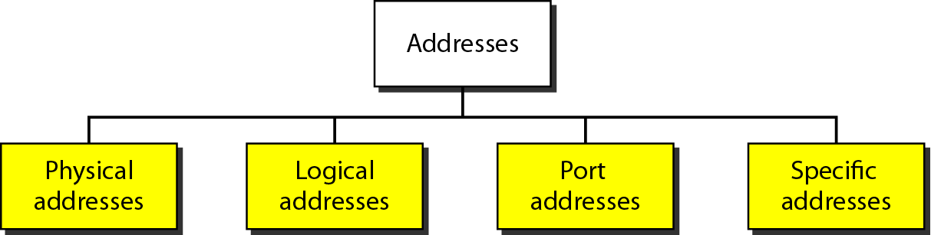
Addressing:
Four levels of addresses are used in an internet employing the TCP/IP protocols: physical, logical, port, and specific.
Sabbir Hossen

Slide 20
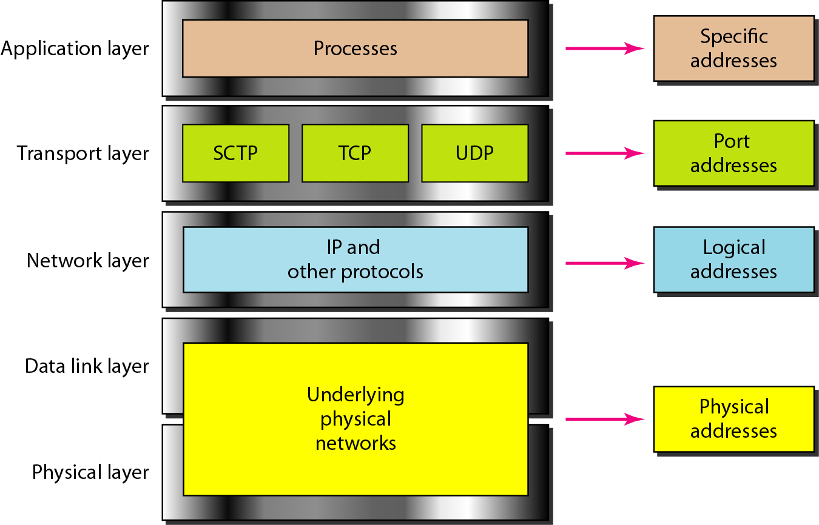
Relationship of layers and addresses in TCP/IP
Sabbir Hossen

Slide 21
Physical Address
Most local-area networks use a 48-bit (6-byte) physical address written as 12 hexadecimal digits; every byte (2 hexadecimal digits) is separated by a colon, as shown below:
07:01:02:01:2C:4B
A 6-byte (12 hexadecimal digits) physical address.
Sabbir Hossen

Slide 22
Logical Address:
Logical Address:
IP Address, 32bit
192.168.0.1
Sabbir Hossen

Slide 23
Port Address:
753
A 16-bit port address represented
as one single number.
Sabbir Hossen

Slide 24
Specific Address:
Example: google, Facebook, URL
The physical addresses will change from hop to hop, but the logical addresses usually remain the same.
Sabbir Hossen

Slide 25
References:
B.A. Forouzan, Data Communications and Networking, 4 rd. Edition.
https://www.tutorialspoint.com/data_communication_computer_network/index.htm
Sabbir Hossen

